Slide 1
Workshop 2 – Extensive Tutorial on Matplotlib
Advanced Analytics and Applications [AAA]
Information Systems for Sustainable Society (is3) | WiSo Faculty | Univ.-Prof. Dr. Wolfgang Ketter | 4/15/20

Slide 2
General Information
GitHub: Workshop material will be uploaded to GitHub
https://github.com/IS3UniCologne/Advanced_Analytics_And_Applications_2020

Slide 3
Administration
Team Assignments:
Form teams of people by next Wednesday (April 22, 2020). You can use the Ilias forum or Slack to find potential group members.
Each group should nominate a contact person which is responsible for the communication with us (e.g., teaching assistant).
This contact person of each group needs to send me an e-Mail by April 22, 2020 (noon) with a list of all team members (name, surname, matriculation ID), a creative team name, and please highlight the name of the contact person.
Especially the topics Kernel Machines, Clustering, Spatial Analytics and Deep Learning should be used by you to successfully complete the team project.
The detailed team project description will be announced at the end of the month (April 29, 2020) via Ilias and/or e-Mail..

Slide 4
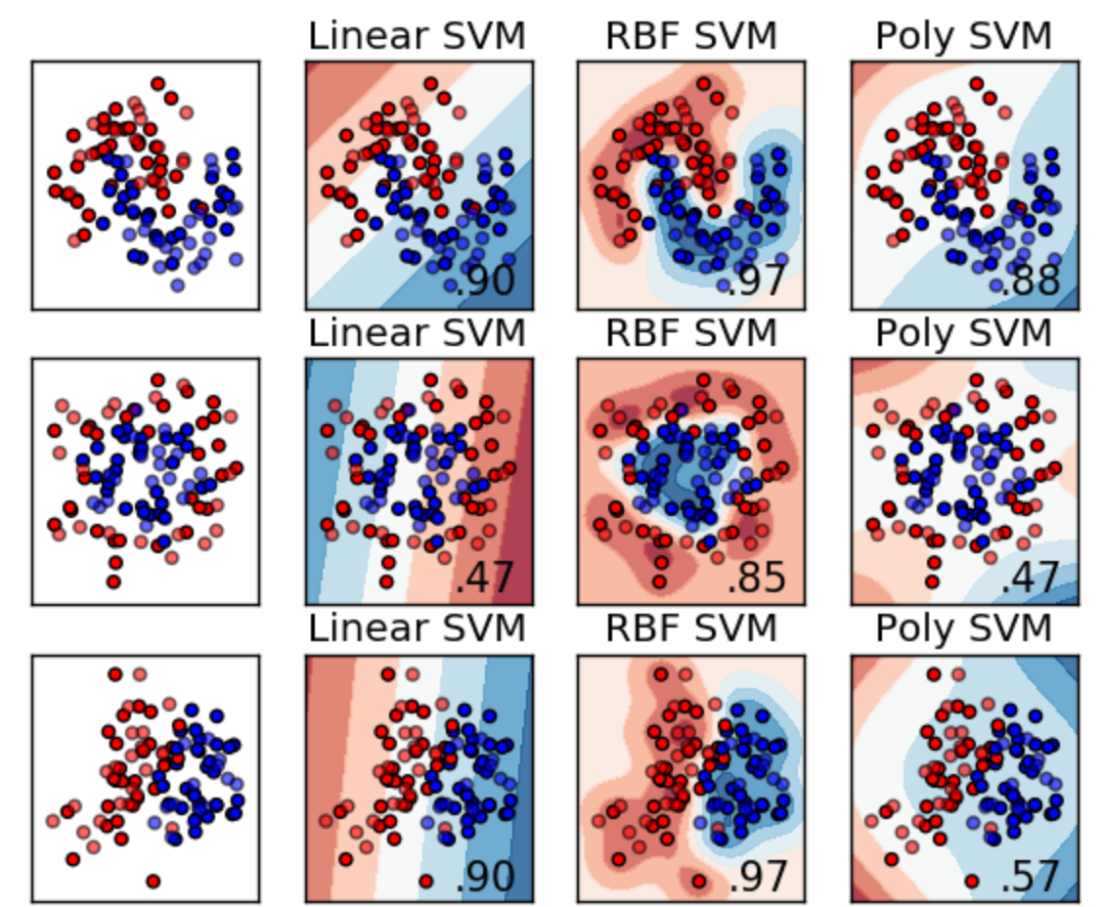
Recap: Kernel Machine Lecture
Popular kernels

Slide 5

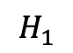
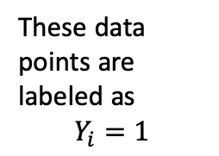
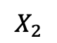
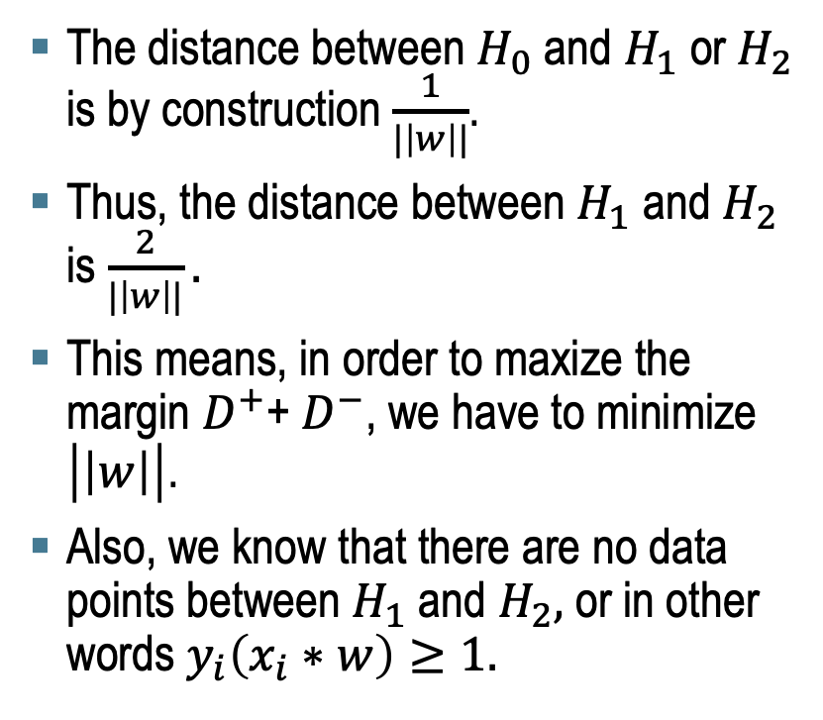
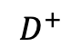
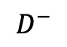
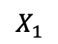
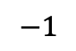
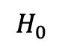

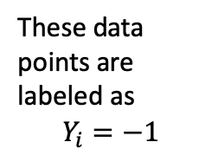
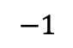
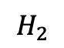
Recap: Kernel Machine Lecture
To derive the quadratic formulation, we need few more definitions
$$X_{2}$$
These data points are labeled as $$Y_{i}=1$$
$$H_{0}$$
The distance between $H_{0}$ and $H_{1}$ or $H_{2}$ is by construction $\frac{1}{|\left|w\right||}$.
Thus, the distance between $H_{1}$ and $H_{2}$ is $\frac{2}{|\left|w\right||}.$
This means, in order to maxize the margin $D^{+}$+ $D^{−}$, we have to minimize $\left|\left|w\right|\right|$.
Also, we know that there are no data points between $H_{1}$ and $H_{2},$ or in other words $y_{i}\left(x_{i}∗w\right)≥1.$
$$1$$
$$H_{1}$$
$$X_{1}$$
$$H_{2}$$
$$−1$$
$$1$$
$$D^{+}$$
$$−1$$
$$D^{−}$$
These data points are labeled as $$Y_{i}=−1$$

Slide 6
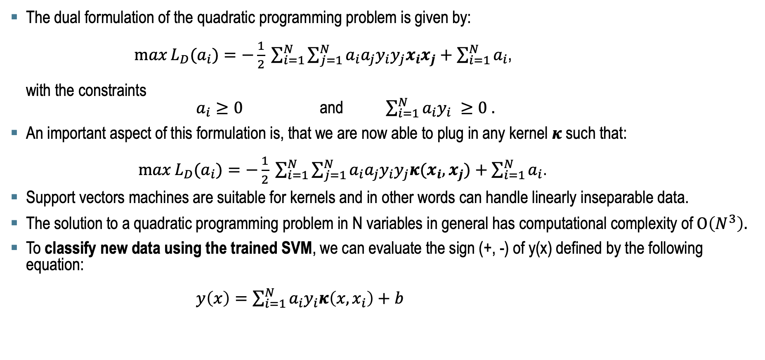
Recap: Kernel Machine Lecture
The Dual Formulation of the Quadratic Programming Problem.
The dual formulation of the quadratic programming problem is given by: $\max{L_{D}(a_{i})}=−\frac{1}{2} \sum_{i=1}^{N}{\sum_{j=1}^{N}{a_{i}a_{j}y_{i}y_{j}x_{i}x_{j}}}+\sum_{i=1}^{N}{a_{i}}$, with the constraints $a_{i}≥0$ and $\sum_{i=1}^{N}{a_{i}y_{i}} ≥0 .$
An important aspect of this formulation is, that we are now able to plug in any kernel $κ$ such that: $\max{L_{D}(a_{i})}=−\frac{1}{2} \sum_{i=1}^{N}{\sum_{j=1}^{N}{a_{i}a_{j}y_{i}y_{j}{κ(x}_{i},x_{j})}}+\sum_{i=1}^{N}{a_{i}}$.
Support vectors machines are suitable for kernels and in other words can handle linearly inseparable data.
The solution to a quadratic programming problem in N variables in general has computational complexity of $Ο\left(N^{3}\right).$
To classify new data using the trained SVM, we can evaluate the sign (+, -) of y(x) defined by the following equation: $y\left(x\right)=\sum_{i=1}^{N}{a_{i}y_{i}κ\left(x, x_{i}\right)+b }$

Slide 7
I
Tools: Matplotlib

Slide 8
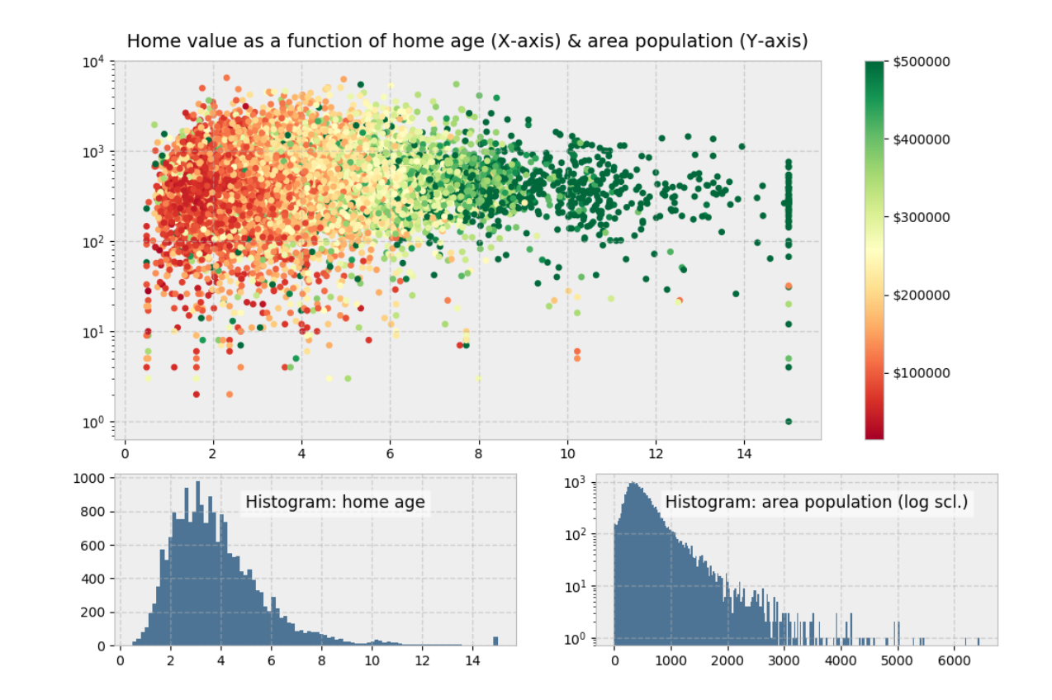
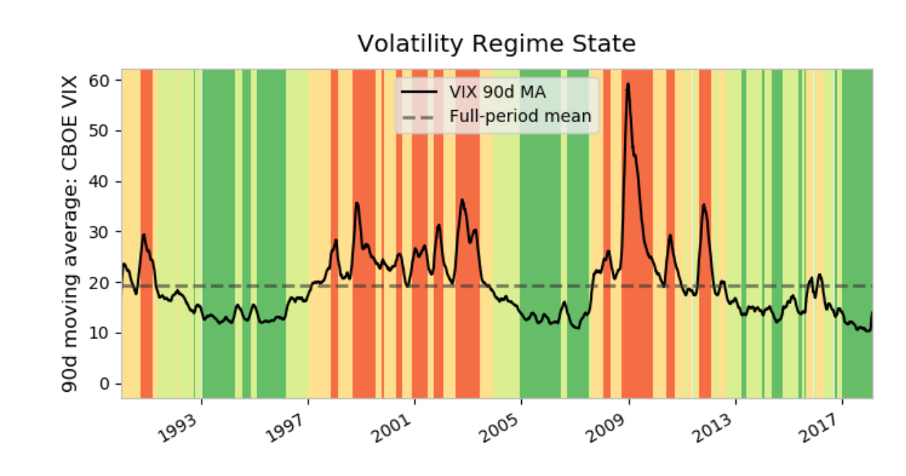
Tools
Matplotlib: Motivation
Source: https://matplotlib.org/3.2.1/contents.html

Slide 9
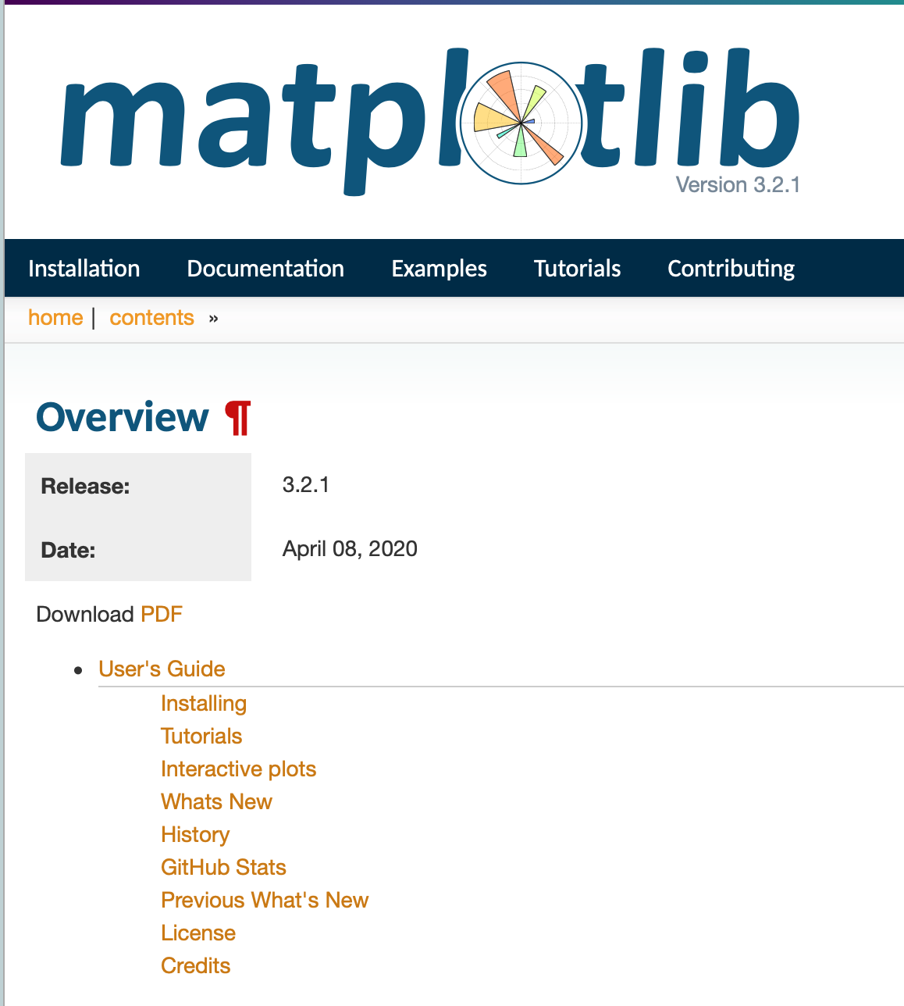
Tools
Matplotlib: Motivation for this workshop
Extensive documentation – The documentation of matplotlib is extensive and in detail BUT also hard for beginners.
Digging through the code is tedious and time-consuming (+70.000 lines).
Thus, we will cover important concept of matplotlib without commencing an "Indiana Jones" like adventure through the codebase.
Source: https://matplotlib.org/3.2.1/contents.html

Slide 10
Tools
Matplotlib: History
John D. Hunter (1968 – 2012) was an American neurobiologist and the original author of matplotlib.
Source: https://www.anaconda.com/distribution/
Notes:
Let’s start with a bit of history: John D. Hunter, a neurobiologist, began developing matplotlib around 2003, originally inspired to emulate commands from Mathworks’ MATLAB software. John passed away tragically young at age 44, in 2012, and matplotlib is now a full-fledged community effort, developed and maintained by a host of others. (John gave a talkabout the evolution of matplotlib at the 2012 SciPy conference, which is worth a watch.)

Slide 11
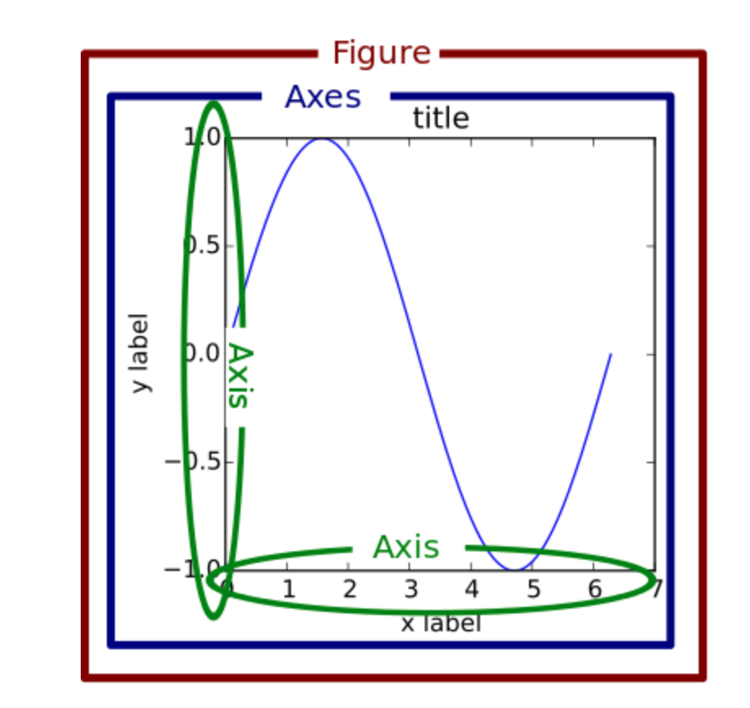
Tools
Matplotlib: The object hierarchy
plt.plot([1, 2, 3])
Create tree-like object hierarchy
Source: https://alchetron.com/John-D-Hunter /
Notes:
Let’s start with a bit of history: John D. Hunter, a neurobiologist, began developing matplotlib around 2003, originally inspired to emulate commands from Mathworks’ MATLAB software. John passed away tragically young at age 44, in 2012, and matplotlib is now a full-fledged community effort, developed and maintained by a host of others. (John gave a talkabout the evolution of matplotlib at the 2012 SciPy conference, which is worth a watch.)

Slide 12
Tools
Matplotlib: Object hierarchy under the hood
Source: https://matplotlib.org/examples/showcase/anatomy.html
Notes:
Let’s start with a bit of history: John D. Hunter, a neurobiologist, began developing matplotlib around 2003, originally inspired to emulate commands from Mathworks’ MATLAB software. John passed away tragically young at age 44, in 2012, and matplotlib is now a full-fledged community effort, developed and maintained by a host of others. (John gave a talkabout the evolution of matplotlib at the 2012 SciPy conference, which is worth a watch.)

Slide 13
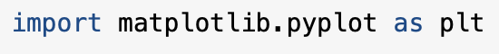
Tools
Matplotlib: Stateful versus Stateless Approach
plt.plot([1, 2, 3])
plt.title(„Hello World“)
plt.ylabels(„Emissions)
Seems like a stateful "enviroment“ but in reality it just mimics stateful behavior.
Source: https://matplotlib.org/examples/showcase/anatomy.html
Notes:
Let’s start with a bit of history: John D. Hunter, a neurobiologist, began developing matplotlib around 2003, originally inspired to emulate commands from Mathworks’ MATLAB software. John passed away tragically young at age 44, in 2012, and matplotlib is now a full-fledged community effort, developed and maintained by a host of others. (John gave a talkabout the evolution of matplotlib at the 2012 SciPy conference, which is worth a watch.)

Slide 14
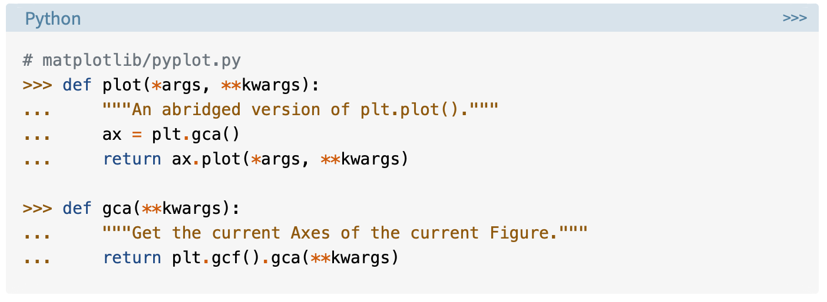
Tools
Matplotlib: Stateful versus Stateless Approach
Applies for almost any function in pyplot
https://realpython.com/python-matplotlib-guide/
Notes:
Let’s start with a bit of history: John D. Hunter, a neurobiologist, began developing matplotlib around 2003, originally inspired to emulate commands from Mathworks’ MATLAB software. John passed away tragically young at age 44, in 2012, and matplotlib is now a full-fledged community effort, developed and maintained by a host of others. (John gave a talkabout the evolution of matplotlib at the 2012 SciPy conference, which is worth a watch.)

Slide 15
Tools
Matplotlib: Stateful versus Stateless Approach
Bottom line: Matplotlib interface is object-oriented and thus is built upon the stateless approach
https://realpython.com/python-matplotlib-guide/
Notes:
Let’s start with a bit of history: John D. Hunter, a neurobiologist, began developing matplotlib around 2003, originally inspired to emulate commands from Mathworks’ MATLAB software. John passed away tragically young at age 44, in 2012, and matplotlib is now a full-fledged community effort, developed and maintained by a host of others. (John gave a talkabout the evolution of matplotlib at the 2012 SciPy conference, which is worth a watch.)

Slide 16
Contact
For general questions and enquiries on research, teaching, job openings and new projects refer to our website at www.is3.uni-koeln.de
For specific enquiries regarding this course contact us by sending an email to the IS3 teaching address at is3-teaching@wiso.uni-koeln.de

